Slide 1
AZ-104T00A Administer Governance and Compliance
Notes:
These Learn modules are part of the AZ-104: Manage identities and governance in Azure (https://docs.microsoft.com/learn/paths/az-104-manage-identities-governance/) path.

Slide 2


Administer Governance and Compliance Introduction
Configure Subscriptions
Configure Azure Policy
Configure Role-Based Access Control
Lab 02a - Manage Subscriptions and RBAC
Lab 02b - Manage Governance via Azure Policy
Lab 03a – Manage Azure resources with the Azure portal
Notes:
Moved Lab 03a – Manage Azure resources with the Azure portal into this module. It covers resource locks.

Slide 3
Administer Governance and Compliance whiteboard and review
tenant root
security - RBAC
developer sandboxes/ production environments
Top level management group
centralized/ decentralized
Azure subscriptions
regions
Sales
IT
- policies
- resource groups
Subscription A
business priorities – cost allocations
Production
Development
technical considerations – resource limits
Subscription B
Subscription C
Notes:
Optional whiteboard slide to introduce the module or review the content. Use the whiteboard diagram directly or recreate the image during the class.
Describe tenants and subscriptions. How are these different?
Answer: An Azure AD tenant is a dedicated and trusted instance of Azure AD. A Tenant is automatically created when your organization signs up for a Microsoft cloud service subscription . An Azure subscription is used to pay for Azure cloud services.
What is Azure Policy?
Answer: Azure Policy is a service in Azure which allows you to create polices which enforce and control the properties of a resource. The advantages include enforcement and compliance, applying policies at scale, and remediating non-compliant resources. The creation steps are - create a policy definition, create a policy initiative, scope the initiative, and determine compliance. A policy example is when a company wants to implement geographic compliance requirements to limit locations where services can be deployed.
What is RBAC?
Answer: RBAC provides fine-grained access management of resources in Azure. RBAC can be used to segregate duties within a team. RBAC can also grant just the amount of access users need to perform their jobs​. RBAC is an allow model granting access only as assigned. Examples: Owner has full access to all resources and can delegate access to others. Contributor can create and manage all types of Azure resources but cannot grant access to others. Reader who can only view Azure resources.
What are resource groups and how are they used?
Answer: A resource group is a container of related resources for an Azure solution. Resources can exist in only one resource group. Groups can have resources of many different types (services) and from many different regions. Groups cannot be nested. Resources (not all) can be moved between resource groups. It is best to add resources which have the same lifecycle management to the same group.
What is resource tagging and why would you use it?
Answer: Resource tags provide metadata for your Azure resources. Tags are name-value pairs that help logically organize resources into a taxonomy. Tags can be used to roll up billing information, for example the costs on a new project. Tags can also be used by Azure policy to determine when a policy should be applied.
Name several ways you can reduce costs in Azure.
Answer: Azure Reservations helps you save money by pre-paying for services. Azure Hybrid Benefits uses Windows Server and SQL Server on-premises licenses with Software Assurance. Azure Credits provides a monthly benefit that allows you to experiment with, develop, and test new solutions on Azure. Regional pricing can be explored to find the most cost-effective location. You can implement Cost Management to conduct a cost analysis, create a budget, and review cost recommendations.
What are resource limits (quotas) and why are they important?
Answer: Resource quotas define the number of resources a user subscription can provision or consume. For example, how many resource groups a subscription can have. It is important to monitor your usage to avoid running up against the limits. Some services have adjustable limits. If you want to raise the limit or quota above the default limit, open an online customer support request at no charge. The limit can be raised above the default limit but not above the maximum limit. It is helpful to track current usage, and plan for future use.

Slide 4
Configure Subscriptions and Configure Azure Resource Manager Resources

Slide 5





Configure Subscriptions Introduction
Identify Regions
Implement Azure Subscriptions
Identify Subscription Usage
Obtain a Subscription
Create Resource Groups
Determine Service Limits and Quotas
Create an Azure Resource Hierarchy
Apply Resource Tagging
Manage Costs
Summary and Resources
Notes:
Manage Azure identities and governance (20–25%)
Manage Azure subscriptions and governance
Configure resource locks
Apply and manage tags on resources
Manage resource groups
Manage subscriptions
Manage costs by using alerts, budgets, and Azure Advisor recommendations
Configure management groups

Slide 6
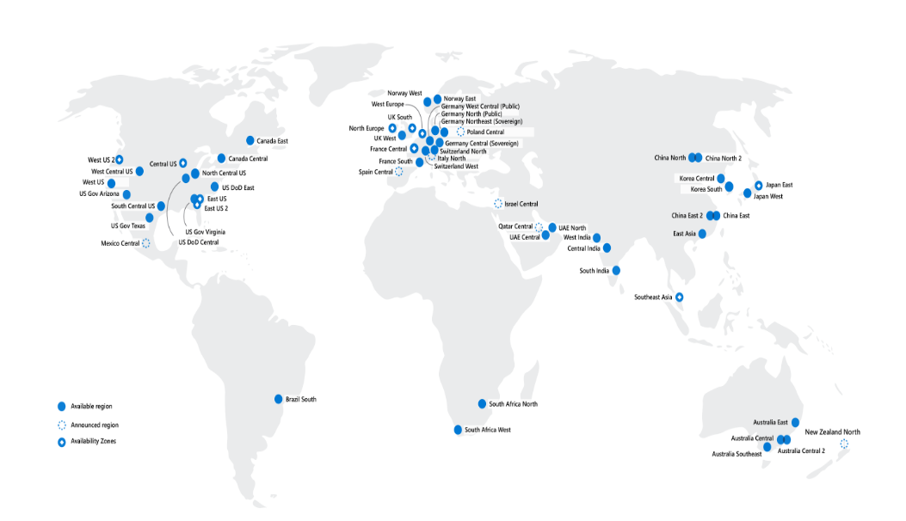
Identify Regions
A region represents a collection of datacenters
Provides flexibility and scale
Preserves data residency
Select regions close to your users
Be aware of region deployment availability
There are global services that are region independent
Worldwide there are 60+ regions representing 140 countries
Regions are paired for high availability
Notes:
A list of regions and their locations is available at https://azure.microsoft.com/global-infrastructure/locations/
Here is a link to the list of regional pairs: https://learn.microsoft.com/azure/reliability/cross-region-replication-azure#azure-cross-region-replication-pairings-for-all-geographies
Microsoft datacenters animation - https://datacenters.microsoft.com/globe/explore
Virtual datacenter tour - https://datacenters.microsoft.com/globe/explore/datacenter

Slide 7
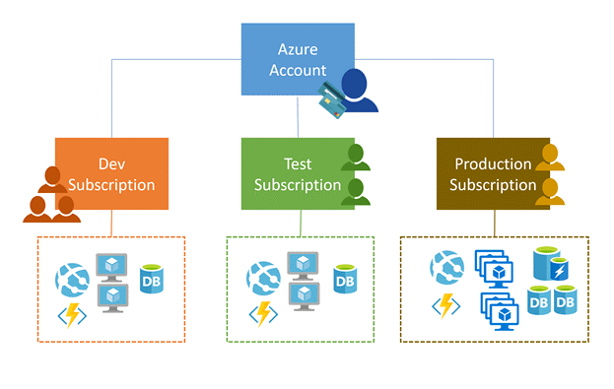
Implement Azure Subscriptions
Only identities in Azure AD, or in a directory that is trusted by Azure AD, can create a subscription
Logical unit of Azure services that is linked to an Azure account
Security and billing boundary*
Notes:
*Clarification on the last bullet - Only Identities in Azure Active Directory (Azure AD) or in a directory that is trusted by Azure AD (such as a work or school organization) can create a Subscription. For example, Account Owner role can be used to create a Subscription in an Enterprise Agreement.
Create an additional Azure subscription - https://docs.microsoft.com/azure/cost-management-billing/manage/create-subscription
Change your Azure subscription to a different offer - https://docs.microsoft.com/azure/cost-management-billing/manage/switch-azure-offer
Subscription considerations and recommendations - https://learn.microsoft.com/azure/cloud-adoption-framework/ready/landing-zone/design-area/resource-org-subscriptions Organize and manage multiple Azure subscriptions - https://learn.microsoft.com/azure/cloud-adoption-framework/ready/azure-best-practices/organize-subscriptions
✔️ Do you know how many subscriptions your organization has?

Slide 8
Identify Subscription Usage
Subscription | Usage
Free | Includes a $200 credit for the first 30 days, free limited access for 12 months
Pay-As-You-Go | Charges you monthly
CSP | Agreement with possible discounts through a Microsoft Cloud Solutions Provider Partner – typically for small to medium businesses
Enterprise | One agreement, with discounts for new licenses and Software Assurance – targeted at enterprise-scale organizations
Student | Includes $100 for 12 months – must verify student access
Notes:
Credit card information is used for identity verification only. You won’t be charged for any services until you upgrade.

Slide 9
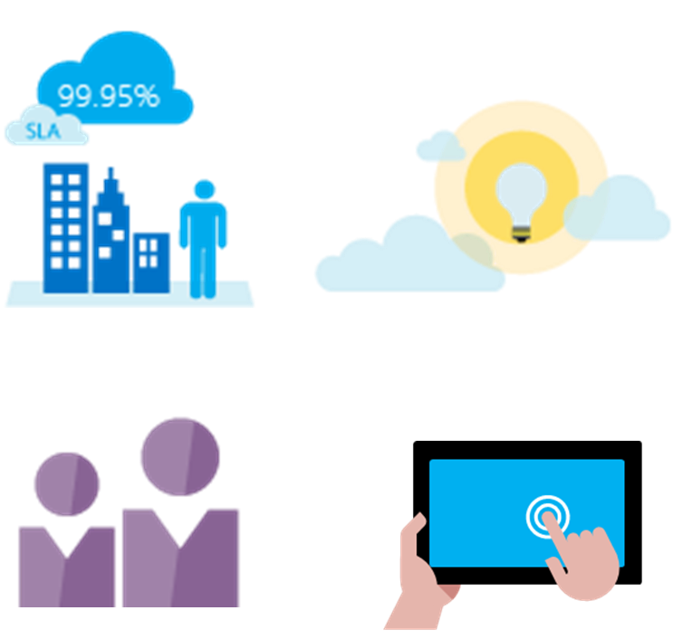
Obtain a Subscription
Enterprise Agreement customers make an upfront monetary commitment and consume services throughout the year
Resellers provide a simple, flexible way to purchase cloud services
Partners can design and implement your Azure cloud solution
Personal free account – Start right away
Notes:
Subscription decision guide - https://docs.microsoft.com/azure/cloud-adoption-framework/decision-guides/subscriptions/
Explore flexible purchasing options for Azure - https://azure.microsoft.com/pricing/purchase-options/
✔️ Which subscription model are you most interested in?

Slide 10
Create Resource Groups
Resources can only exist in one resource group
Resources grouped (Web + DB, VM, Storage) in one group
Groups can have resources of many different types (services) and from many different regions
OR
Groups cannot be renamed or nested
Web and DB resource group
Virtual machine resource group
Storage resource group
You can move resources between groups
Notes:
Manage Azure Resource Manager resource groups by using the Azure portal - https://docs.microsoft.com/azure/azure-resource-manager/management/manage-resource-groups-portal
There is an excellent Learn module, Use Azure resources, https://learn.microsoft.com/training/modules/use-azure-resource-manager/. This covers the Azure Resource Manager, resources, limits, locks, and groups.

Slide 11
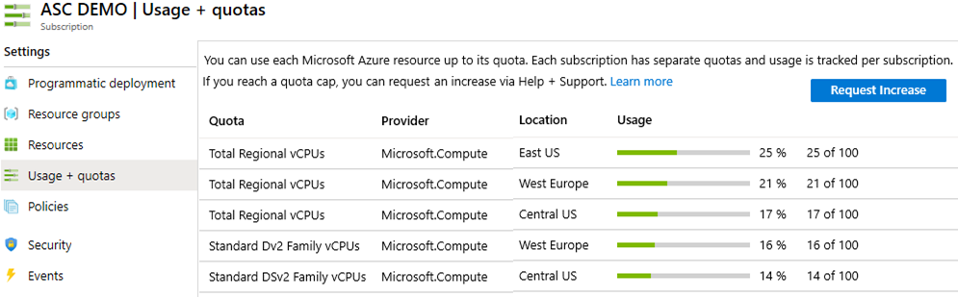
Determine Service Limits and Quotas
Resources have a default limit - a subscription quota
Helpful to track current usage, and plan for future use
You can open a free support case to increase limits to published maximums
Notes:
Azure subscription and service limits, quotas, and constraints - https://docs.microsoft.com/azure/azure-resource-manager/management/azure-subscription-service-limits

Slide 12
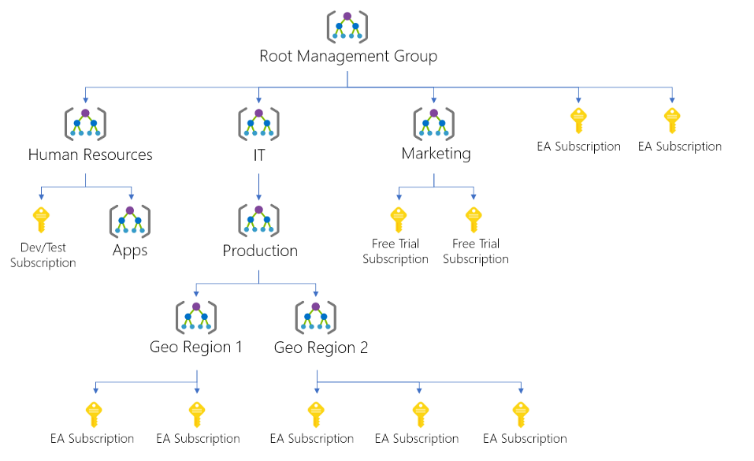
Create an Azure Resource Hierarchy
Management groups provides a level of scope above subscriptions
Target policies and spend budgets across subscriptions and inheritance down the hierarchies
Implement compliance and cost reporting by organization (business/teams)
* To prevent changes, apply resource locks at the subscription, resource group, or resources level
Notes:
Create management groups for resource organization and management - https://docs.microsoft.com/azure/governance/management-groups/create
Manage your resources with management groups - https://docs.microsoft.com/azure/governance/management-groups/manage

Slide 13
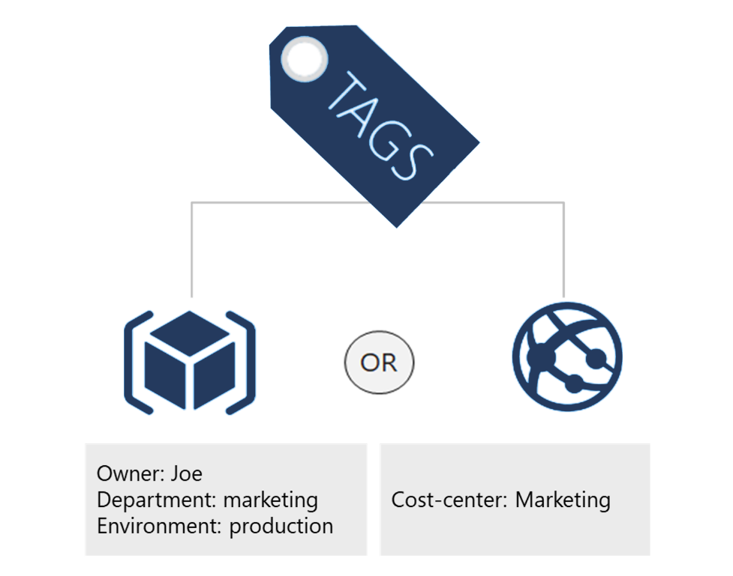
Apply Resource Tagging
Provides metadata for your Azure resources
Logically organizes resources
Consists of a name-value pair
Very useful for rolling up billing information
Notes:
Resource naming and tagging decision guide - https://docs.microsoft.com/azure/cloud-adoption-framework/decision-guides/resource-tagging
✔️ If you need to create a lot of tags you will want to do that programmatically. You can use PowerShell or the CLI.

Slide 14
Manage Costs
Costs are resource-specific
Usage costs may vary between locations
Costs for inbound and outbound data transfers differ
Pre-pay with Azure reserved instances
Use your on-premises licenses with Azure Hybrid Benefit
Optimize with alerts, budgets, and Azure Advisor recommendations
Notes:
Azure usage charges - https://docs.microsoft.com/azure/billing/billing-understand-your-invoice
There are six primary factors affecting costs:
Resource Type: Costs are resource-specific, so the usage that a meter tracks and the number of meters associated with a resource depend on the resource type.
Services: Azure usage rates and billing periods can differ between Enterprise, Web Direct, and CSP customers.
Location: The Azure infrastructure is globally distributed, and usage costs might vary between locations that offer Azure products, services, and resources.
Bandwidth: Some inbound data transfers are free, such as data going into Azure datacenters. For outbound data transfers, such as data going out of Azure datacenters, pricing is based on Zones.
Azure Reservations: Azure Reservations allow you to prepay for one-year or three-years of virtual machine or SQL Database compute capacity. Pre-paying will allow you to get a discount on the resources you use. Azure reservations can significantly reduce your virtual machine or SQL database compute costs — up to 72 percent on pay-as-you-go prices with one-year or three-year upfront commitment. Reservations provide a billing discount and don't affect the runtime state of your virtual machines or SQL databases.
Azure Hybrid Benefit: If you already have Windows Server or SQL Server licenses in your on-premises deployments, you can use the Azure Hybrid Benefit program to save in Azure. With the Windows Server benefit, each license covers the cost of the OS (up to two virtual machines), and you only pay for base compute costs. You can use existing SQL Server licenses to save up to 55 percent on vCore-based SQL Database options. Options include SQL Server in Azure Virtual Machines and SQL Server Integration Services.

Slide 15
Summary and Resources - Configure Subscriptions
Knowledge Check Questions
Microsoft Learn Modules (docs.microsoft.com/Learn)
Introduction to analyzing costs and creating budgets with Azure Cost Management
Plan and manage your Azure costs (Sandbox)
Control and organize Azure resources with Azure Resource Manager
Use Azure Resource manager
A sandbox indicates a hands-on exercise.
Notes:
Learn - https://docs.microsoft.com/learn/browse/
The Assessment Guide in the MCT DLC has open-ended questions.
What is resource tagging and why would you use it?
Answer: Resource tags provide metadata for your Azure resources. Tags are name-value pairs that help logically organize resources into a taxonomy. Tags can be used to roll up billing information, for example the costs on a new project. Tags can also be used by Azure policy to determine when a policy should be applied.
Name several ways you can reduce costs in Azure
Answer: Azure Reservations helps you save money by pre-paying for services. Azure Hybrid Benefits uses Windows Server and SQL Server on-premises licenses with Software Assurance. Azure Credits provides a monthly benefit that allows you to experiment with, develop, and test new solutions on Azure. Regional pricing can be explored to find the most cost-effective location. You can implement Cost Management to conduct a cost analysis, create a budget, and review cost recommendations.

Slide 16
Configure Azure Policy
Notes:
Manage Azure identities and governance (20–25%)
Manage Azure subscriptions and governance
Implement and manage Azure Policy

Slide 17
Configure Azure Policy Introduction
Implement Azure Policy
Create Azure Policies
Demonstration – Azure Policies
Create Policy Definitions
Create and Scope the Initiative Definition
Determine Compliance
Summary and Resources
Notes:
Manage Azure identities and governance (15-20%)
Manage subscriptions and governance
Configure and manage Azure Policy

Slide 18
Implement Azure Policies
A service to create, assign, and manage policies
Usage Cases
Allowed resource types – Specify the resource types that your organization can deploy
Allowed virtual machine SKUs – Specify a set of virtual machine SKUs that your organization can deploy
Allowed locations – Restrict the locations your organization can specify when deploying resources
Require tag and its value – Enforces a required tag and its value
Azure Backup should be enabled for Virtual Machines – Audit if Azure Backup service is enabled for all Virtual machines
Runs evaluations and scans for non-compliant resources
Advantages:
Enforcement and compliance
Apply policies at scale
Remediation
Notes:
What is Azure Policy? - https://docs.microsoft.com/azure/governance/policy/overview
Quickstart: Create a policy assignment to identify non-compliant resources - https://docs.microsoft.com/azure/governance/policy/assign-policy-portal

Slide 19


Create Azure Policies
Define and create
Scope and assign
Assess compliance
Policy Initiative
Policy Definition(s)
Notes:
Walk-through the Tutorial: Create and manage policies to enforce compliance - https://docs.microsoft.com/azure/governance/policy/tutorials/create-and-manage
Or do the Demonstration (in the MCT DLC).
Or just walk through the slides.
Apply and monitor infrastructure standards with Azure Policy (Learn) - https://docs.microsoft.com/learn/modules/intro-to-governance/
The next topics step you through creating an Azure policy.
✔ Even if you have only a few Policy Definitions, we recommend creating an Initiative Definition.

Slide 20
Demonstration – Azure Policy
Assign a policy
Create and assign an initiative definition
Check for compliance
Check for remediation tasks
Remove your policy and initiative
Notes:
Tutorial: Build policies to enforce compliance - Azure Policy - https://docs.microsoft.com/azure/governance/policy/tutorials/create-and-manage

Slide 21
Summary and Resources – Configure Azure Policy
Knowledge Check Questions
Microsoft Learn Modules (docs.microsoft.com/Learn)
Introduction to Azure Policy
Build a cloud governance strategy on Azure
Notes:
Learn - https://docs.microsoft.com/learn/browse/
The Assessment Guide in the MCT DLC has open-ended questions.
Describe the steps for creating an Azure policy. What are the advantages of Azure policy?
Answer: Azure Policy is a service in Azure which allows you create polices which enforce and control the properties of a resource. The advantages include enforcement and compliance, applying policies at scale, and remediating non-compliant resources. The creation steps are - create a policy definition, create a policy initiative, scope the initiative, and determine compliance. A policy example is when company wants to implement geographic compliance requirements to limit locations where services can be deployed.

Slide 22
Configure Role-Based Access Control

Slide 23
Configure Role-Based Access Control Introduction
Compare Azure RBAC Roles to Azure AD Roles
Create a Role Definition
Create a Role Assignment
Apply RBAC Authentication
Demonstration – Azure RBAC
Summary and Resources
Notes:
Manage Azure identities and governance (20–25%)
Manage access to Azure resources
Manage built-in Azure roles
Assign roles at different scopes
Interpret access assignments

Slide 24

Compare Azure RBAC Roles to Azure AD Roles
RBAC roles provide fine-grained access management
Azure RBAC roles | Azure AD roles
Manage access to Azure resources | Manage access to Azure AD objects
Scope can be specified at multiple levels | Scope is at the tenant level
Role information can be accessed in the Azure portal, Azure CLI, Azure PowerShell, Azure Resource Manager templates, REST API | Role information can be accessed in Azure portal, Microsoft 365 admin portal, Microsoft Graph, Azure Active Directory PowerShell for Graph
There are many built-in roles, or you can create your own custom role
Notes:
You may want to cover this slide after discussing the next 3 slides which explain what RBAC is.

Slide 25
Create a Role Definition
Collection of permissions that lists the operations that can be performed
Contributor
Owner
Contributor
Reader
…
Backup Operator
Security Reader
User Access Administrator
Virtual Machine Contributor
"Actions": [
"*"
],
"NotActions" : [
"Authorization/*/Delete",
"Authorization/*/Write",
"Authorization/elevateAccess/Action"
],
"DataActions" : [],
"NotDataActions": [],
"AssignableScopes" : [
"/"
]
Built-in
Reader Support Tickets
Virtual Machine Operator
Custom
Notes:
List role definitions in Azure RBAC - https://docs.microsoft.com/azure/role-based-access-control/role-definitions-list
Create custom roles for Azure resources with role-based access control - https://docs.microsoft.com/learn/modules/create-custom-azure-roles-with-rbac/
Extra slide at the end on built-in roles - Determine Azure RBAC Roles.

Slide 26




Create a Role Assignment
Process of binding a role definition to a user, group, or service principal at a scope for the purpose of granting access
1
Security principal
User
Group
Service principal
2
Role definition
Role assignment
3
Scope
Owner
Contributor
Reader
…
Backup Operator
Security Reader
Contributor
"Actions": [
"*"
],
"NotActions": [
"Auth/*/Delete",
"Auth/*/Write",
"Auth/elevate"
]
Management group
Marketing group
Subscription
Resource group
Pharma-sales Resource group
Reader Support Tickets
Virtual Machine Operator
Contributor
Resource
Notes:
Add or remove role assignments using Azure RBAC and the Azure portal - https://docs.microsoft.com/azure/role-based-access-control/role-assignments-portal
Explain that the role assignment completes the process of implementing RBAC and combining service principals, a role definition, and a scope.

Slide 27





Apply RBAC Authentication
Azure AD
Admin roles
Azure Active
Directory tenant
Global admin
Application admin
Application developer
Billing admin …
Global admin/User access admin (elevated access)
Root
Azure RBAC
roles
Root management group
Owner
Contributor
Reader
User access admin
…
Management group
Subscription
Azure RBAC
roles
Resource group
Azure account
Owner
Contributor
Reader
User access admin
…
Resource
Notes:
Manage access to an Azure subscription by using Azure role-based access control - https://docs.microsoft.com/learn/modules/manage-subscription-access-azure-rbac/3-elevate-your-access-user-access-admin

Slide 28
Demonstration – Azure RBAC
Locate the Access Control blade
Review role permissions
Add a role assignment
Explore PowerShell commands
Notes:
Tutorial: Grant a user access to Azure resources using the Azure portal - https://docs.microsoft.com/azure/role-based-access-control/quickstart-assign-role-user-portal
Quickstart: Check access for a user to Azure resources - https://docs.microsoft.com/azure/role-based-access-control/check-access

Slide 29
Summary and Resources – Configure RBAC
Knowledge Check
Microsoft Learn Modules (docs.microsoft.com/Learn)
Create custom roles for Azure resources with Azure role-based access control
Manage access to an Azure subscription by using Azure role-based access control
Secure your Azure resources with Azure role-based access control (Sandbox)
A sandbox indicates a hands-on exercise.
Notes:
Learn - https://docs.microsoft.com/learn/browse/
The Assessment Guide in the MCT DLC has open-ended questions.
List three RBAC roles and the associated permissions for each role.
Answer: Owner who has full access to all resources and can delegate access to others. Contributor who can creates and manages all types of Azure resources but cannot grant access to others. Reader who can only view Azure resources. User access administrator who manages user access to Azure resources. Other roles are possible.
What is the purpose of role-based access control (RBAC) and why would you use it?
Answer: RBAC provides fine-grained access management of resources in Azure. RBAC can be used to segregate duties within a team. RBAC can also grant just the amount of access users need to perform their jobs​. RBAC is an allow model granting access only as assigned.

Slide 30
Lab 02a - Manage Subscriptions and RBAC Lab 02b - Manage Governance via Azure Policy Lab 03a – Manage Azure resources with the Azure portal
Notes:
Go ahead and cover Lab 03a which includes the portal review and resource locks.

Slide 31
Lab 02a – Manage Subscriptions and Azure RBAC
Lab scenario
To improve the management of Azure resources in Contoso, you have been tasked with implementing the following functionality:
Using management groups for the Contoso’s Azure subscriptions
Granting user permissions for submitting support requests. This user would only be able to create support request tickets and view resource groups
Objectives
Task 1: Implement Management Groups
Task 2: Create custom RBAC roles
Task 3: Assign RBAC roles
Next slide for an architecture diagram
Notes:
LAB 02a - Manage Subscriptions and RBAC - ESTIMATED DURATION 30 MIN
Lab Repository - https://microsoftlearning.github.io/AZ-104-MicrosoftAzureAdministrator/

Slide 32
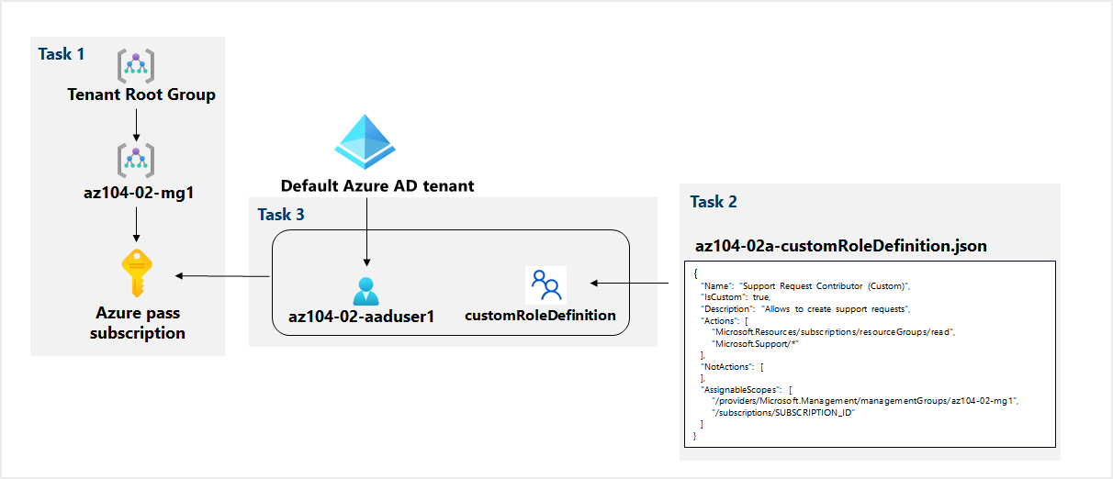
Lab 02a – Architecture diagram

Slide 33
Lab 02b – Manage Governance via Azure Policy
Lab scenario
To improve management of Azure resources in Contoso, you have been tasked with implementing the following functionality:
Tagging resource groups that include only infrastructure resources
Ensuring that only properly tagged infrastructure resources can be added to infrastructure resource groups
Remediating any non-compliant resources
Objectives
Task 1: Create and assign tags via the Azure portal
Task 2: Enforce tagging via an Azure Policy
Task 3: Apply tagging via an Azure Policy
Next slide for an architecture diagram
Notes:
LAB 02b - Manage Governance via Azure Policy - ESTIMATED DURATION 30 MIN
Lab Repository - https://microsoftlearning.github.io/AZ-104-MicrosoftAzureAdministrator/

Slide 34


Lab 02b – Architecture diagram
Task 1
Name: Role
Value: Infra
Task 2
Cloud Shell Storage
Resource Group
Azure policy
Require a tag and its value on resources
Cloud Shell Storage Account
Task 3
Azure policy
Inherit a tag from the resource group if missing
New Storage Account

Slide 35
Lab 03a – Manage Azure resources with the Azure portal
Lab scenario
You need to explore the basic Azure administration capabilities associated with provisioning resources and organizing them based on resource groups, including moving resources between resource groups. You also want to explore options for protecting disk resources from being accidentally deleted, while still allowing for modifying their performance characteristics and size
Objectives
Task 1: Create resource groups and deploy resources to resource groups
Task 2: Move resources between resource groups
Task 3: Implement and test resource locks
Next slide for an architecture diagram
Notes:
Consider doing this lab now, since resource groups and locks were covered.
LAB 03a - Manage Azure resources by Using the Azure Portal - ESTIMATED DURATION 20 MIN
GitHub Repository - https://microsoftlearning.github.io/AZ-104-MicrosoftAzureAdministrator/

Slide 36


Lab 03a – Architecture diagram
Task 1
Task 2
az104-03a-rg1
az104-03a-rg2
Move resource
az104-03a-disk1
az104-03a-disk1
Task 3
az104-03a-rg3
az104-03a-delete-lock
Type: Delete
az104-03a-disk2

Slide 37

End of presentation

Slide 38
Implement Role-Based Access Control
Provides fine-grained access management of resources in Azure​
Concepts​
Built on Azure Resource Manager
Segregate duties within your team ​
Grant only the amount of access to users that they need to perform their jobs​
Security principal. Object that represents something that is requesting access to resources​
Role definition. Collection of permissions that lists the operations that can be performed​
Scope. Boundary for the level of access that is requested​
Assignment. Attaching a role definition to a security principal at a particular scope​:
Users can grant access described in a role definition by creating an assignment​
Deny assignments are currently read-only and are set by Azure Blueprints and Azure Managed Apps
Notes:
What is role-based access control (RBAC) for Azure resources? - https://docs.microsoft.com/azure/role-based-access-control/overview

Slide 39
Determine Azure RBAC Roles
RBAC role in Azure | Permissions | Notes
Owner | Has full access to all resources and can delegate access to others | The Service Administrator and Co-Administrators are assigned the Owner role at the subscription scope. This applies to all resource types
Contributor | Creates and manages all types of Azure resources but cannot grant access to others | This applies to all resource types
Reader | Views Azure resources | This applies to all resource types
User Access Administrator | Manages user access to Azure resources | This applies to managing access, rather than to managing resources
Notes:
Custom roles for Azure resources - https://docs.microsoft.com/azure/role-based-access-control/custom-roles

Slide 40
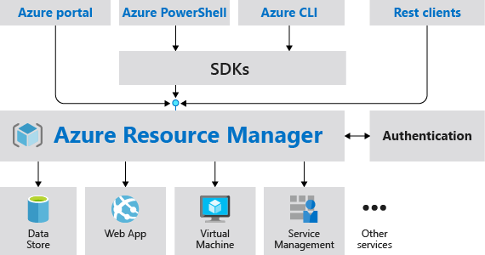
Review Resource Manager Benefits
Provides a consistent management layer
Enables you to work with the resources in your solution as a group
Deploy, update, or delete in a single, coordinated operation
Provides security, auditing, and tagging features
Choose the tools and APIs that work best for you
Notes:
What is Azure Resource Manager? - https://docs.microsoft.com/azure/azure-resource-manager/management/overview

Slide 41
Review Azure Resource Terminology
A resource is simply a single service instance in Azure
A resource group is a logical grouping of resources
An Azure Resource Manager template is a JSON file that allows you to declaratively describe a set of resources
A declarative syntax is what a template uses to state what you intend to create
A resource provider is service that supplies the resources you can deploy and manage through Resource Manager

Slide 42
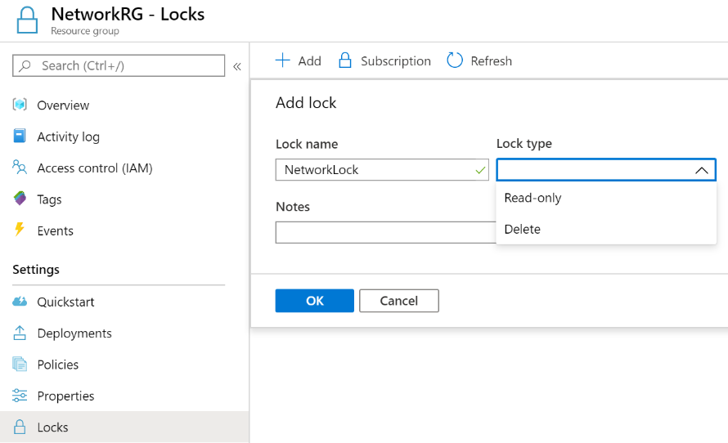
Create Resource Manager Locks
Associate the lock with a subscription, resource group, or resource
Locks are inherited by child resources
Read-Only locks prevent any changes to the resource
Delete locks prevent deletion
Notes:
Lock resources to prevent unexpected changes: https://docs.microsoft.com/azure/azure-resource-manager/resource-group-lock-resources
Control and organize Azure resources with Azure Resource Manager - https://docs.microsoft.com/learn/modules/control-and-organize-with-azure-resource-manager/
✔ Only Owner and User Access Administrator roles can create or delete management locks.

